Slide 1
SATHISH V
2021503706
Final Project
3/21/2024 Annual Review

Slide 2
PROJECT TITLE
[LICENSE PLATE RECOGNITION USING CNN]
In this presentation, I will discuss an approach to license plate recognition using convolutional neural networks (CNNs).
CNNs are a type of deep learning architecture that has been highly successful in image recognition tasks.
In this project, we will use a CNN to classify images of license plates and extract the characters from them.
This technology can be used for a variety of applications, such as automated toll collection, traffic monitoring, and law enforcement.
3/21/2024 Annual Review

Slide 3


AGENDA
Problem Statement
Project Overview
Who Are the End Users?
Your Solution and Its Value Proposition
The Wow in Your Solution
Modeling
Result
This slide outlines the agenda for the presentation. We will begin by discussing the problem of license plate recognition and then provide an overview of our project. We will then identify the end users of this technology and discuss the value proposition of our solution. Next, we will highlight the unique features of our approach.
3/21/2024 Annual Review

Slide 4

PROBLEM STATEMENT
Manual license plate recognition is a time-consuming and error-prone process.
Automated license plate recognition systems can improve efficiency and accuracy.
This project aims to develop a CNN-based license plate recognition system for Indian license plates.
Automated license plate recognition systems can address these challenges by offering faster and more accurate recognition.
This project focuses on building a CNN-based system specifically designed to recognize Indian license plates, which have a unique format and character set.
3/21/2024 Annual Review

Slide 5
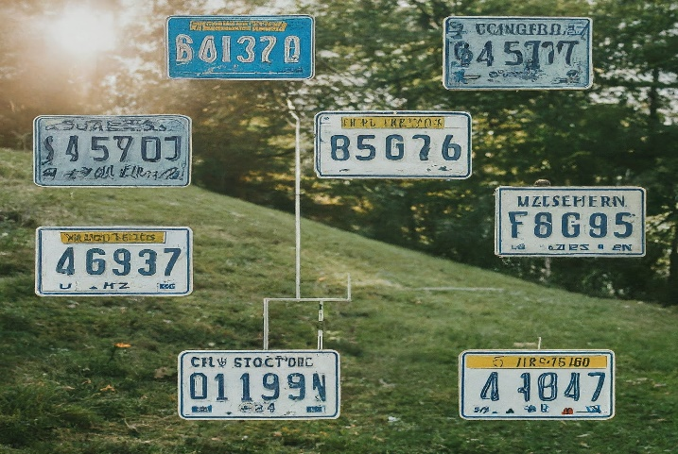

PROJECT OVERVIEW
This project develops a CNN model for recognizing Indian license plates.
The model is trained on a dataset of Indian license plate images.
The trained model can then be used to recognize license plates in real-world images.
This project involves building a CNN model for license plate recognition. The model will be trained on a dataset of Indian license plate images. After training, the model can be used to recognize license plates in new images captured in real-world scenarios.
3/21/2024 Annual Review

Slide 6

WHO ARE THE END USERS?
Law enforcement agencies: Can use the system to identify vehicles of interest
Tolling authorities: Can use the system to automate toll collection.
Parking management companies: Can use the system to automate parking enforcement.
Security companies: Can use the system to control access to restricted areas.
The target audience for this license plate recognition system includes various stakeholders who can benefit from automated license plate recognition capabilities.
Law enforcement agencies can leverage the system to identify vehicles involved in criminal activities or those listed on watchlists.
Parking management companies can enforce parking rules and regulations more efficiently. Security companies can implement the system to control access to restricted areas and enhance security measures.
3/21/2024 Annual Review

Slide 7

YOUR SOLUTION AND ITS VALUE PROPOSITION
Our CNN-based license plate recognition system offers several advantages
High accuracy: The CNN model can achieve high accuracy in recognizing Indian license plates.
Efficiency: The system can process images quickly, making it suitable for real-time applications.
Scalability: The system can be easily scaled to accommodate larger datasets and higher processing demands.
Cost-effective: The system can be implemented using readily available hardware and software resources.
The proposed CNN-based license plate recognition system provides several key benefits. The CNN model is designed to achieve high accuracy in recognizing Indian license plates, ensuring reliable results. The system is efficient and can process images quickly, making it suitable for real-time applications where speed is crucial.
3/21/2024 Annual Review

Slide 8

THE WOW IN YOUR SOLUTION
Our system can handle variations in lighting conditions, image quality, and license plate fonts.
It can recognize license plates from different angles and distances.
The system can be integrated with other intelligent transportation systems for improved traffic management.
One of the unique aspects of our solution is its robustness. The system can handle variations in lighting conditions, image quality, and license plate fonts,
3/21/2024 Annual Review

Slide 9
MODELLING
Convolutional Neural Networks (CNNs) are a type of artificial neural network that is well-suited for image recognition tasks.
CNNs consist of multiple layers of neurons that are arranged in a grid-like fashion.
Each layer of a CNN learns to detect specific features in the input image.
Convolutional Neural Networks (CNNs) are a type of artificial neural network that is well-suited for image recognition tasks. CNNs consist of multiple layers of neurons that are arranged
3/21/2024 Annual Review

Slide 10
RESULTS
Present the performance of your CNN model on the test dataset.
Include metrics like accuracy, precision, and recall for character recognition.
You can show visualizations of correctly and incorrectly recognized license plates.
Briefly discuss any challenges faced during training and how you addressed them.
Demo Link
3/21/2024 Annual Review

